Slide 1
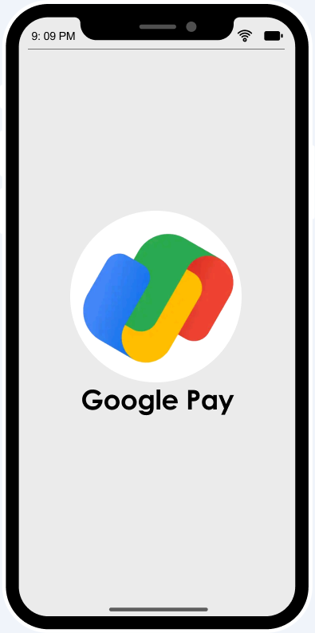
Innovate: PM Case Challenge 2021
Customer Success (CX) Team
for
Google Pay
A simple and secure payment app
- Team Zireael
Akshay & Sravan

Slide 2
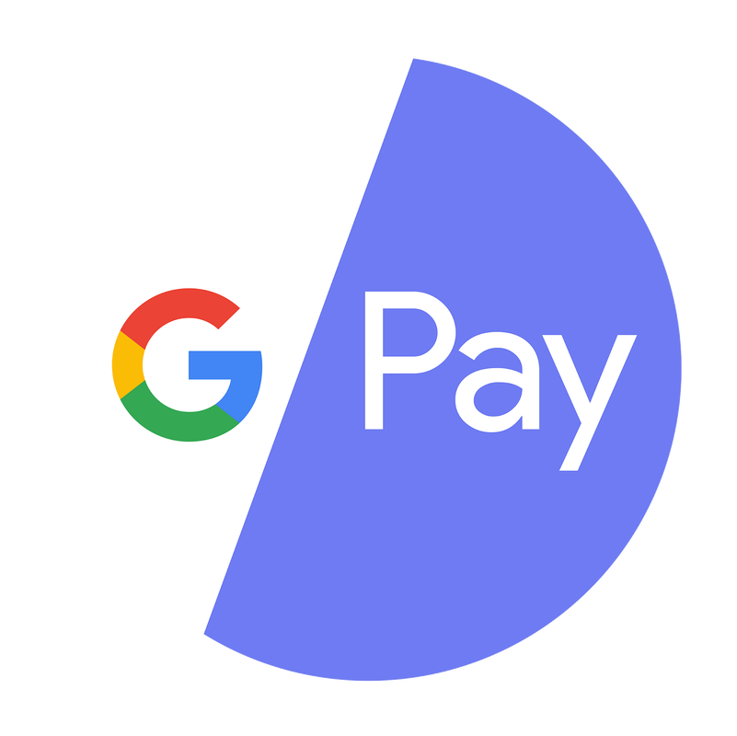
Google Pay "CX TEAM"
What is CX Team ?
CX Team is a group of employees who will be helping our customers coming through different channels to answer problems faced using our payment app and interact with product development and engineering teams to query resolutions where CX team wont be able to
Why CX Team ?
Had 67 million users in India, as of September 2019, over 3 million merchants in June 2020 with a total payment value of USD 110 billion on an annualized basis
Acquiring new digital payment users and attracting competitor users because of UX/UI design and ease in payment processing steps, there has been increase in traffic on its platform, ultimately leading to server and payment errors.
Also G Pay is regularly updating its app, but unable to fix some bugs and customers are facing new issues
To address customer problems and provide user feedback to product development teams, CX team has to be created.

Slide 3
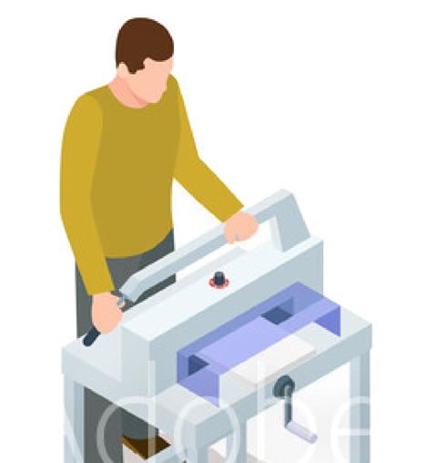



USER PERSONAS
Gangareddy
48 | Owns a printing press | Bhainsa (Rural) Telangana
Ramesh Kande
39 | Runs family hotel business |
Nizamabad(Semi Urban), TS
Aaryan Singh
20 | Student at IIT(ISM) Dhanbad
Rashmi Kiran
25 | SDE at Morgan Stanley |
Mumbai, MH
Runs a printing press and due to negative cashflow, he borrows finance amount from others to purchase paints and equipments.
Uses cash to pay his lent amount to borrowers
For the first time, uses Gpay to pay the amount digitally, but faces issues in registering mobile number and adding bank account
He quits, uses PhonePe to pay
Owns a tiffin center(hotel), opens at 4 am to prepare the food, serves customers at 6 am
A Gpay Business merchant, he receives payments from customers frequently
He sees successful payment notification at customer’s end, but do not receive at his end, then after contacting helpdesk he receives payment after 1or 2 days
Where he faces some discrepancy in daily accounts, a miscalculation of 3k to 5k
Uses Gpay for any transactions in college; paying at canteen or sending money to friends or receiving money from parents
Frequently buys snacks and beverages at canteen, but app lags much and takes longer time to land payment page
Also faces bank server problems and notices poor UI/UX and frequent bank server connectivity problem.
Instead he uses PhonePe or PayTM to pay it.
Attends office in day hours, being a foodie, she explores different cuisines at different restaurants
She doesn’t carry cash, instead uses Google Pay to pay at restaurants.
In many of the times, she attempts payment for the first time, but fails, so she sends it for the second time, but money gets deducted twice
She calls customer care for support, but it takes weeks to receive the refund, but she gets irritated if its huge amount

Slide 4
FLOWCHART
USER
Faces the problem
Goes to profile
Taps help, support & feedback
Navigates to FAQs
Help Centre
LiveChat with GPay Bot
Not solved?
Shows problem category
AUTOMATED SUPPORT
Gets the details of exact problem
Not solved?
Bot presents/provides the solution
Solved?
Solved?
Connects in live chat with CX
Connects in voice with CX
Unable to solve?
CX Team asks or searches in ‘Product CX community’
Solved?
Not solved?
CX & PRODUCT TEAM
Solved?
Solved?
Not solved?
Customer support calls back/emails customer
Still unsolved?
Marks issue as pending and sends tracking id in the form of message/email
Developer/Product teams answers the problem
FEEDBACK
CUSTOMER FEEDBACK

Slide 5
TOOLS & TECHNOLOGIES TO BE USED
AUTOMATED SUPPORT
Using NLP modelling to find major issues by users
Using recent customer reviews on Google Play store to analyze
Extract keywords or phrases to find major problems and optimizing our workforce.
This can be built using Jupyter notebook and Natural Language Processing(NLP) technology.
MAJOR COMPLAINTS RAISED BY USERS
*Of users (sampled 50 critical reviews from Google Play store)
Bank server
Rewards
Transactions
Accounts
Product functioning
Bank server error
Server is not responding
Doesn’t give cashback
Gets rewards that doesn’t matter
Money got deducted, not refunded
Frequent payment failure
Long time for payment processing
More time to credit into recipient account
Have to re-enter all bank details
Unable to verify the account
Every time prompts re-verification process
Not loading(Showing only white page)
After update, not able to login(account is suspended)
16%
14%
74%
28%
38%
Google Pay Chatbot feature
Google Pay can built this on their own using NLP and other related tools
Can integrate chatbot using SaaS companies like Chatbot, Chatbotcreater, etc.

Slide 6
CX & PRODUCT TEAM
Live chat with customer executive
Integrating ‘chatbot messaging’ with LiveChat messaging with customer support
Software can be deployed to the platform provided by SaaS companies like LiveChat, Olark, etc.
Computer calling
Web-tool to be built to call the customer through browser to connect him/her with voice to understand the problem clearly.
Should incorporate a feature ‘automatic caller information screen pop’ where it provides caller’s information(picture, name, company, etc.) in browser, which allows to provide a more personalized experience to each and every customer
Product CX community forum
An informational forum to be created where CX team to interact with internal departments
To provide query resolutions CX won’t be able to improve
CX team’s knowledge about GPay product using PHP or Web development
FEEDBACK
Customer feedback analysis
Analyzing data collected from customer surveys using Tableau or Power BI or using NLP to comprehend texts to improve product

Slide 7
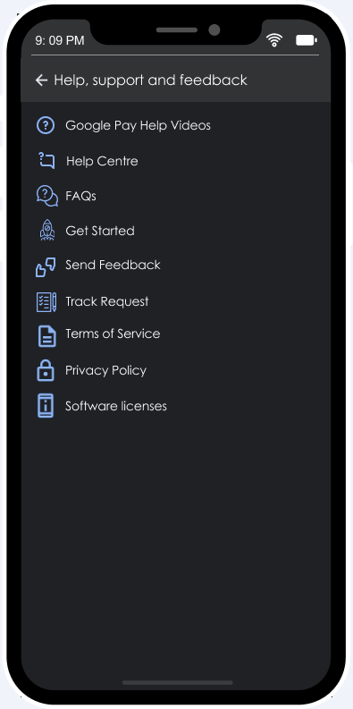
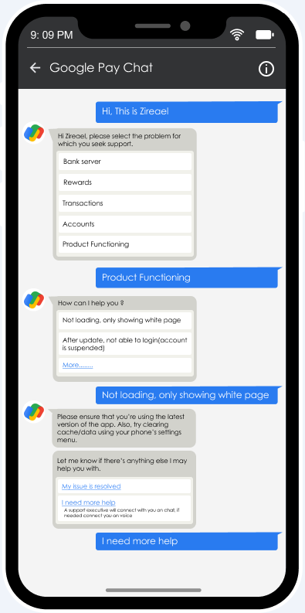
GOOGLE PAY USER WIREFRAMES
Helps users to solve basic and simple issues through self service
This is category of problems faced more frequently and evaluated through NLP modelling
Takes customers to Automated Support to chat with Google Pay bot and if needed; chat with support executive and a call with CX team.
These are automated responses generated by user by tapping on given options
Gives the information regarding any pending or unresolved issue

Slide 8
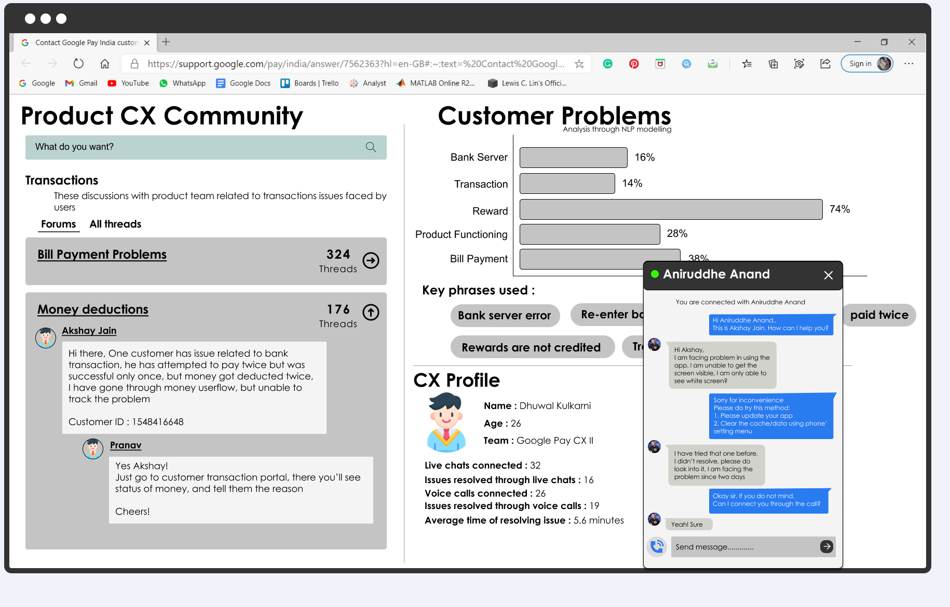
CX TEAM WIREFRAMES

Slide 9
SUCCESS METRICS FOR EVALUATION
CUSTOMER SATIFACTION
CX TEAM
Net Promoter Score
Customer Retention Rate
Customer Churn Rate
Customer Lifetime Value
Number of Issues solved
Number Issues solved by GPay bot
Number of Issues solved by CX Team Members through Live Chat
Number of Issues solved by CX Team Members through Voice Calls
Number of Pending Issues after contacting CX Team
Average Time of Resolving an Issue by CX Team Member

Slide 10

PRESS RELEASE
"Google Pay enables its users to solve their issues through CX Team(2021)"
Highlights:
Google Pay has started serving its customers through CX Teams.
The newly built CX Team helps users solve their server issues, transaction queries, and provides information regarding rewards.
Google Pay has been observing higher Customer Churn Rates since their last three updates.
Unprecedented levels of market uncertainty paired with new guidelines on how to serve customers during the pandemic has forced Google Pay to reimagine their interactions with customers. Aspects of customer experience (CX) are integral to a brand experience and hence, Google Pay refurbishes it's CX Team.
The Chat Bot enabled by Google Pay is capable of solving basic and simple issues and thus serves as the first line of customer support. If the issues still persist, customers can go in LiveChat or Voice Call with the customer support executives.
In this way, the newly formed Google Pay CX Team now interacts closely with their customers, solving their problems more efficiently than ever.

Slide 11
Thank You.
Akshay Jain
-Team Zireael-
Alsatwar Sravan Kumar

